Slide 1
A drug combination approach to plexiform neurofibromas Gleukos Team: Shuo Gu, Alex Li

Slide 2
Drug combination
Complex diseases
Diseases with unknown targets
Robust synergy
Tackle drug resistance

Slide 3
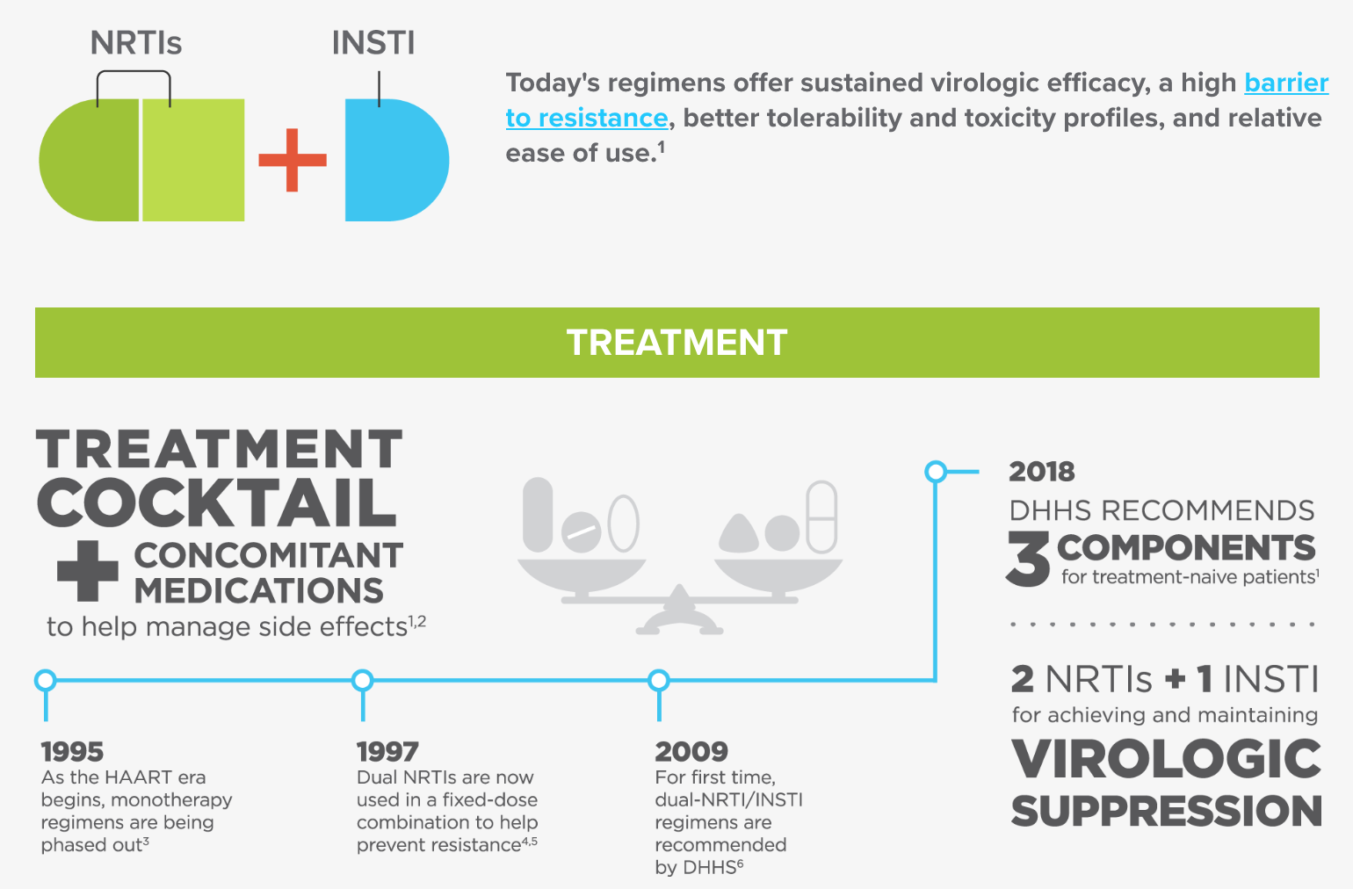
A Cocktail Therapy for AIDS

Slide 4
Plexiform neurofibromas
Plexiform neurofibromas (pNFs) could a serious type of Neurofibromatosis.
It impact ~40% of people with Neurofibromatosis Type 1.
Higher mortality rate: 5%

Slide 5
From drug screening data…

Slide 6
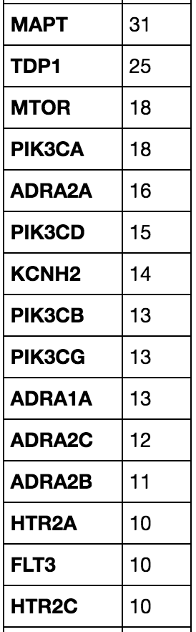
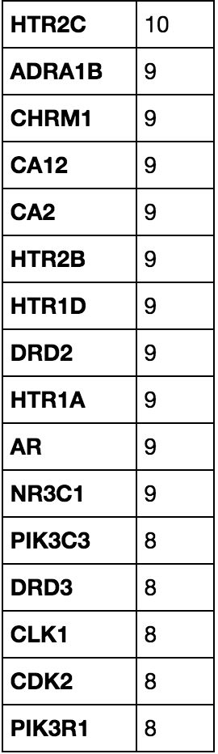
Top associated gene/targets

Slide 7
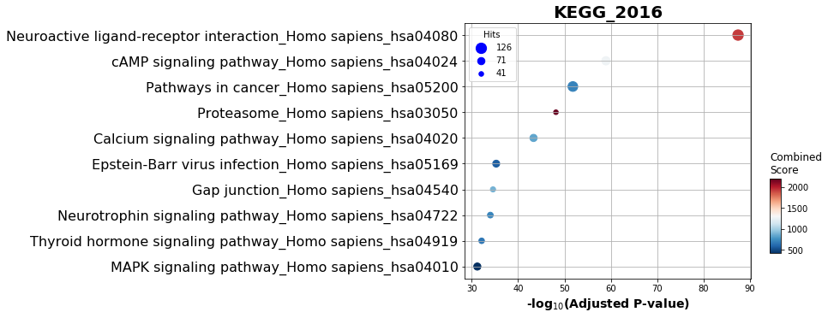
Top 10 enriched pathways mapped on KEGG

Slide 8
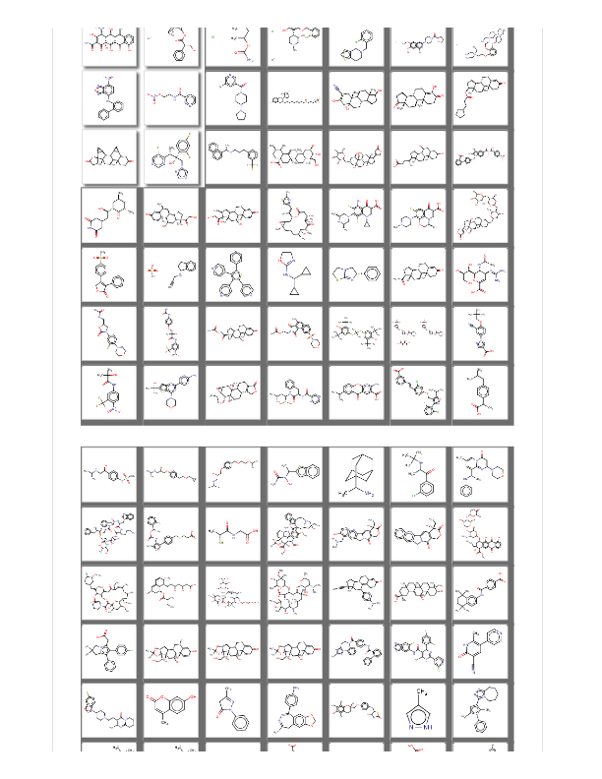
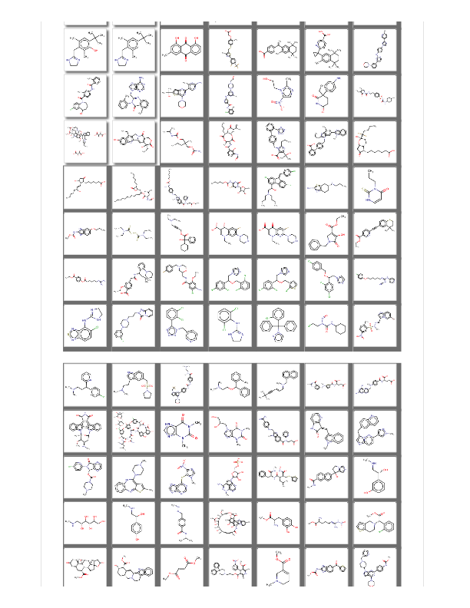
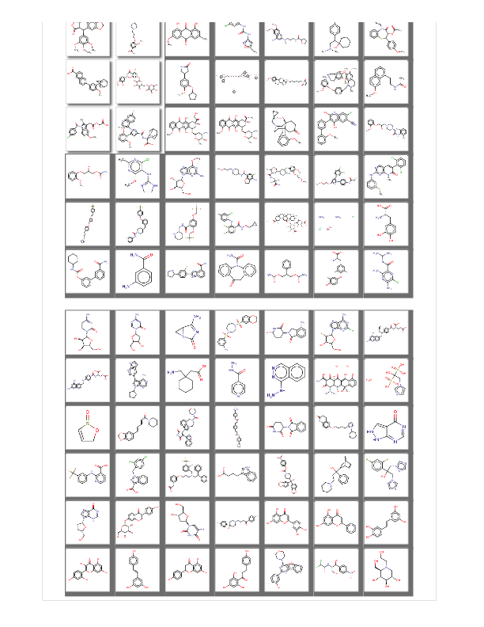
Selected compounds for future study

